Slide 1
02 | Web API Basic Design
Jeremy Likness | Principal Architect
Christopher Harrison | Content Developer

Slide 2
Module Overview
Defining the Resource
Verbs and Web API
Content Negotiation
Tools for Testing (Fiddler, PostMan)
Consuming a REST API using jQuery

Slide 3
Defining the Resource
How to plan the API

Slide 4
Defining the Resource
Collection or Singleton: /widgets or /widgets/1
Navigation: /widgets/1/things or /widgets/1/things/1
Nouns
“Target of a hypertext reference”
Avoid exposing business logic, i.e. if a process requires orchestration across multiple resources, make the process the noun
In Web API, a resource is typically a controller

Slide 5
Resource Examples (Twitter)
Users
Statuses
User_timeline
Home_timeline
Retweets_of_me
Retweets
Retweeters
Followers
Trends

Slide 6
Resource Examples (Azure API Mgmt.)
/apis
/apis/1/operation
/apis/1/policy
/authorizationServers
/certificates
/products
/users
/users/1/subscriptions
Etc.

Slide 7
Verbs
How to plan actions in your API

Slide 8
Verbs and Web API
GET – “read”
POST – “insert” (collection)
PUT – “replace”
DELETE – “remove”
PATCH – “update”
Custom (proceed with caution)

Slide 9
Practical example: Account Transfer
/accounts
How do I transfer $5 from /accounts/1 to /accounts/2?
Attempt #1:
Deduct $5 by PUT /accounts/1
Add $5 by PUT /accounts/2
Problems:
Too much business knowledge
No transfer id to map back to
Lack of transaction – what happens if it breaks after the deduction?
/accounts
/accounts/1
/accounts/2

Slide 10
Practical example: Account Transfer
Attempt #2
Create a transaction under account
POST /accounts/1/transfers { amount: 5, targetAccount: 2 }
Query /accounts/1/transfers/1
Better!
Does /accounts/1 “own” the transaction?
Is it evident that /accounts/2 is impacted?
What if you are navigating /accounts/2 … how do you know a transaction happened?
/accounts
/accounts/1
/transfers

Slide 11
Practical example: Account Transfer
Suggestion
The “noun” is the transaction
POST /transactions { src: 1, amount: 5, tgt: 2 }
Query /transactions/srcAccount or transactions/tgtAccount
(reference back up to /accounts/1 and /accounts/2)
Clear spot to navigate from and models that the accounts are “participants” in the transaction
Guess what …
There is no “right” or “perfect” way
/transfers
/transfers/1
/srcAccount
/tgtAccount

Slide 12
Case Study: GitHub API
Notes:
https://developer.github.com/v3/ -> start at https://api.github.com/users/jeremylikness and drill down

Slide 13
Content Negotiation
How to generate forms (XML, JSON, etc.)

Slide 14
Content Negotiation
Apps consume content in different ways
For example, XML used to be the most popular format
Now of course JSON is most popular
A good service should support multiple content types
A good client will request the favored type
Out of the box, Web API handles provisioning content based on common requests

Slide 15
Content Negotiation
Notes:
Show solution example, but add header Accept application/xml, show result, then change to text/xml and show result

Slide 16
Tools for Testing
Test the API without having to write the entire app!

Slide 17
Tools for Testing
Web API 2.2 Help Page
Generates documentation to validate your API routes and parameters
Install-Package Microsoft.AspNet.WebApi.HelpPage
If your project did not already include MVC, add a call to AreaRegistration.RegisterAllAreas in WebApiConfig
http://www.asp.net/web-api/overview/getting-started-with-aspnet-web-api/creating-api-help-pages

Slide 18
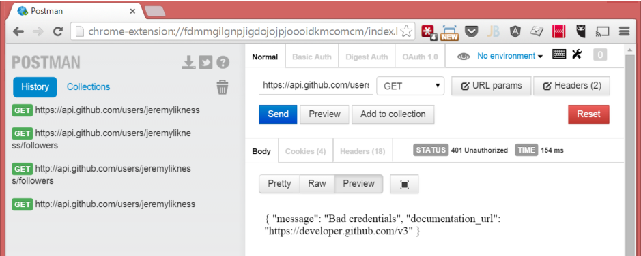
Tools for Testing
Postman Chrome extension
http://bit.ly/postmanext
Fiddler by Telerik
http://www.Telerik.com/fiddler

Slide 19
Using Testing Tools
Notes:
Send request using PostMan, and capture using Fiddle, then show how to construct (Replay from Composer), change back to json

Slide 20
Consuming REST with jQuery
(or why JSON is such a good thing™)

Slide 21
Consuming a RESTful API with jQuery
$.ajax
Verbs (PUT, POST, GET)
URL (resource)
Data
DataType
JSON makes it really, really easy to turn into a JavaScript object

Slide 22
Consuming a RESTful API with jQuery
Notes:
02aContentNegotiation – 02bjQuery.html

